Slide 1
january 12
network enumeration + basic attacks
week 02

Slide 2
Some Announcements & Reminders

Slide 3



Assigned Mentors
drew levy
Original Plan: 1 assigned mentor for each team
New Plan: No assigned mentors, any mentor can help any team and will “float” around
Mentor, CPTC co-lead at cyber @ uci
dhruv kandula
Mentor, CPTC co-lead at cyber @ uci
sterling gip
Mentor, CTF lead at cyber @ uci

Slide 4
Mentors’ Office Hours
Dhruv 4:00 - 5:00 PM on Monday’s
Drew 12:30 - 1:30 PM on Thursday’s
Sterling 2:00 - 3:00 PM on Friday’s

Slide 5



A reminder of your teams….
Canopy Accord
(team canopy)
Harmonics Group
(team harmony)
Steelbound
(team steel)
Pranath Chamarthi
Sanjay Marathe
Sophia Raldugina-Zhu
Benjamin Thai
Justin Ahn
Bryan Liu
Omar Shalash
Yengkai Yang
Ryan Guan
Jason Guieb
Tara Pai
Zahi Imaduddin

Slide 6
Discovering the network environment
First entry in machines

Slide 7
Content
1
Network Basics
2
Enumeration
3
Basic Attacks
4
5
6

Slide 8
Network Fundamentals

Slide 9
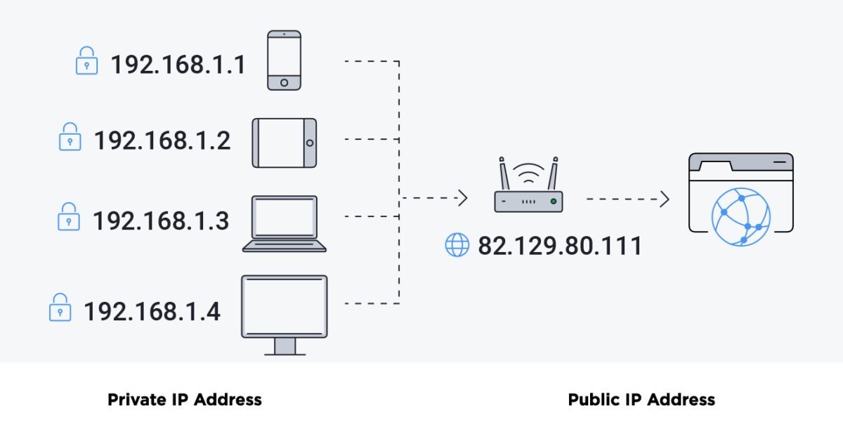
IP Addresses
A unique identifier for a machine on a network.
Required to communicate with a device over the network
Example: Street number, street name

Slide 10
IP Fundamentals
10 . 100 . 10 . 1
Static IP: A permanent, unchanging IP Address.
Dynamic IP: A temporary IP Address, typically automatically assigned by the network.
May be reassigned after some time, or on reconnection.

Slide 11
Ports
Allows for network data to be redirected to the correct service / application.
A port cannot exist without an ip address.
Example: Mailbox

Slide 12
Enumeration

Slide 13
Enumeration
The process of gathering information of a network’s hosts (devices), services, and users.
This can be achieved with two distinct tools, which are complementary to each other.
NMAP: Network Mapper, scans an ip or range of ips to determine active hosts, open ports, and services.
enum4linux: Scans an ip which must contain SMB, to determine users, groups, password policies, and much more.

Slide 14
Scanning
nmap 10.100.10.0-255
Nmap is a tool used to map networks, scan ports, and identify services.
The range of ips, 10.100.10.0-255 is the target of the scan

Slide 15
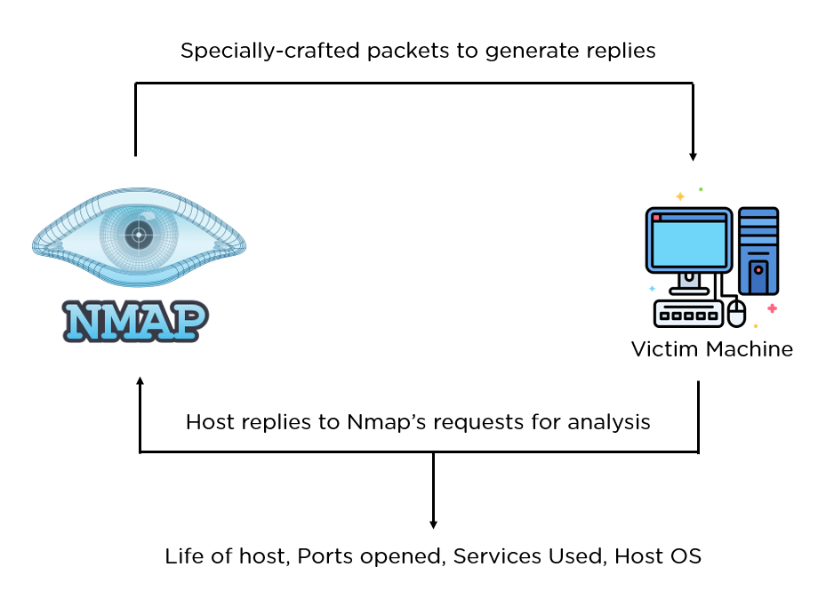
Port Scanning
nmap 10.100.10.1
The result of an nmap scan can show what services are running on the machine based on the ports and responses.
10.100.10.1 is the target of the scan

Slide 16
Port Scanning
nmap -sV -p 1-65535 -T3 45.33.32.156
nmap: Command to use nmap
-sV: Determine the service and version of open ports
-p 1-65535: Scan ports from 1 to 65536
-T3: Default scan speed (1-5: 1 slowest, 5 most aggressive)
45.33.32.156: The target of the scan

Slide 17
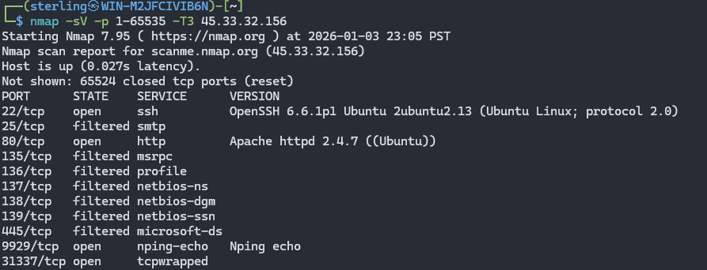
Port Scanning
nmap -sV -p 1-65535 -T3 45.33.32.156

Slide 18
Port Scanning - Demo
nmap -sV -p 1-65535 -T3 10.100.62.83
nmap: Command to use nmap
-sV: Determine the service and version of open ports
-p 1-65535: Scan ports from 1 to 65536 (equivalent to -p-)
-T3: Default scan speed (0-5: 1 slowest/stealthiest, 5 most aggressive)
10.0.1.159: The target of the scan

Slide 19
Common Services
Port | Service
80 | HTTP (HyperText Transfer Protocol)
22 | SSH (Secure SHell)
443 | HTTPS (HyperText Transfer Protocol Secure)
21 | FTP (File Transfer Protocol)
25 | SMTP (Simple Mail Transfer Protocol)
3306 | MySQL
8080 | HTTP-alt
3389 | RDP (Remote Desktop Protocol)
445, 139 | SMB (Server Message Block)

Slide 20
Enumeration
enum4linux
Can only be used when the server has Server Message Block (SMB)
Usable WITHOUT credentials if the Null Session on SMB is allowed
Used to gather information about:
Users and groups
Shares (drives and folders)
Password policies

Slide 21
Enumeration
enum4linux -a -u Administrator -p password123 10.100.10.1
-a: Do all simple enumeration
-u: Uses the given user
-p: Uses the given password
10.100.10.1: Target IP of machine

Slide 22
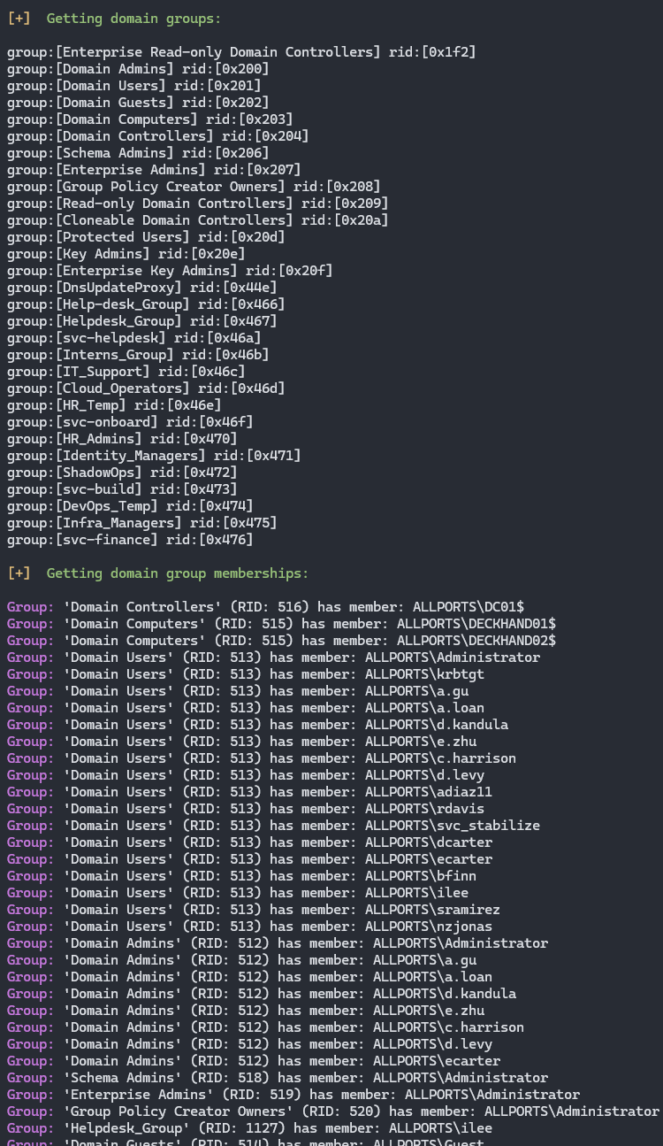
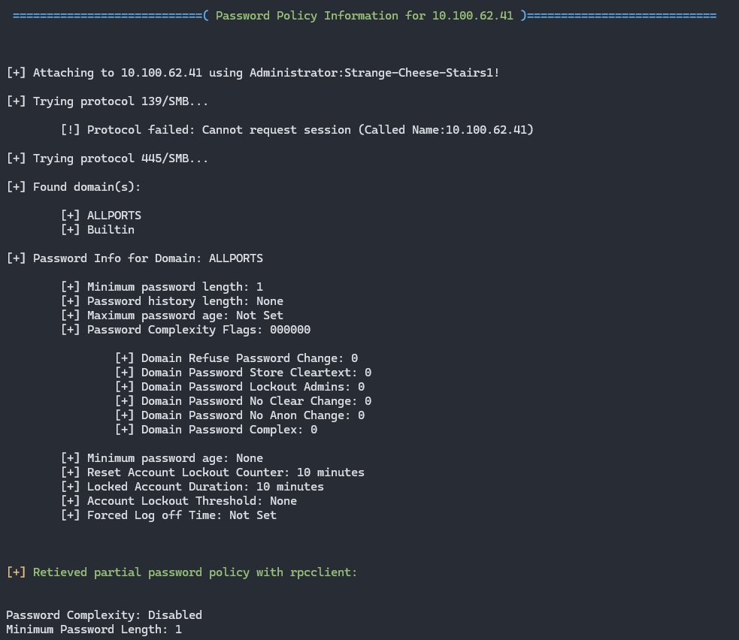
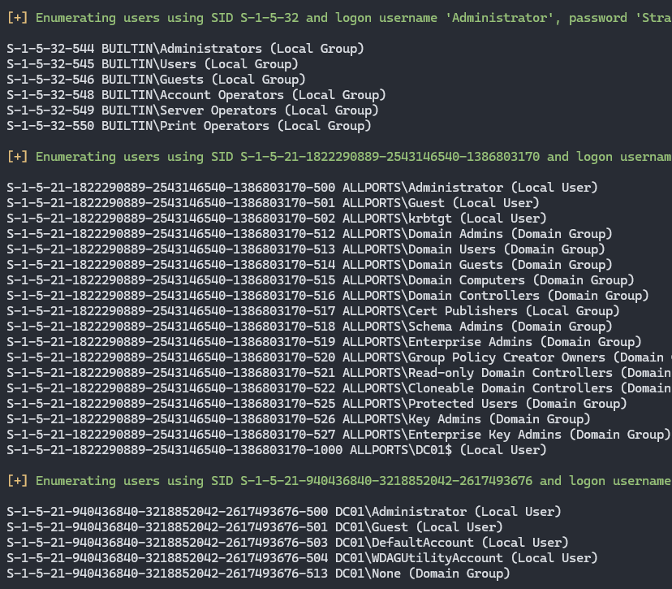
Enumeration
enum4linux -a -u Administrator -p password123 10.100.10.1

Slide 23
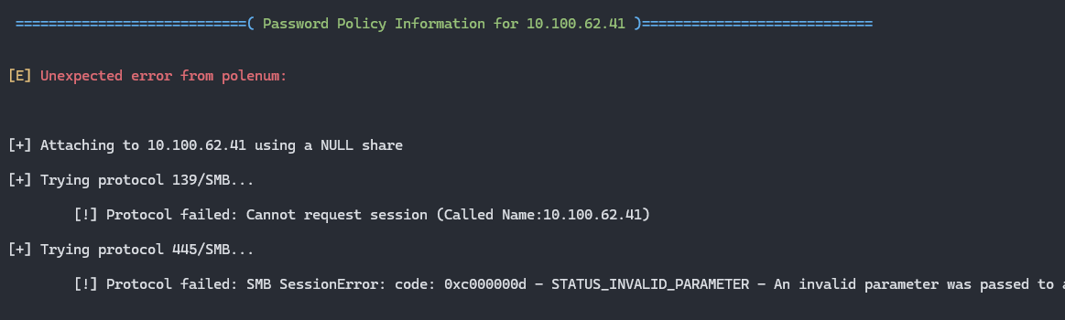
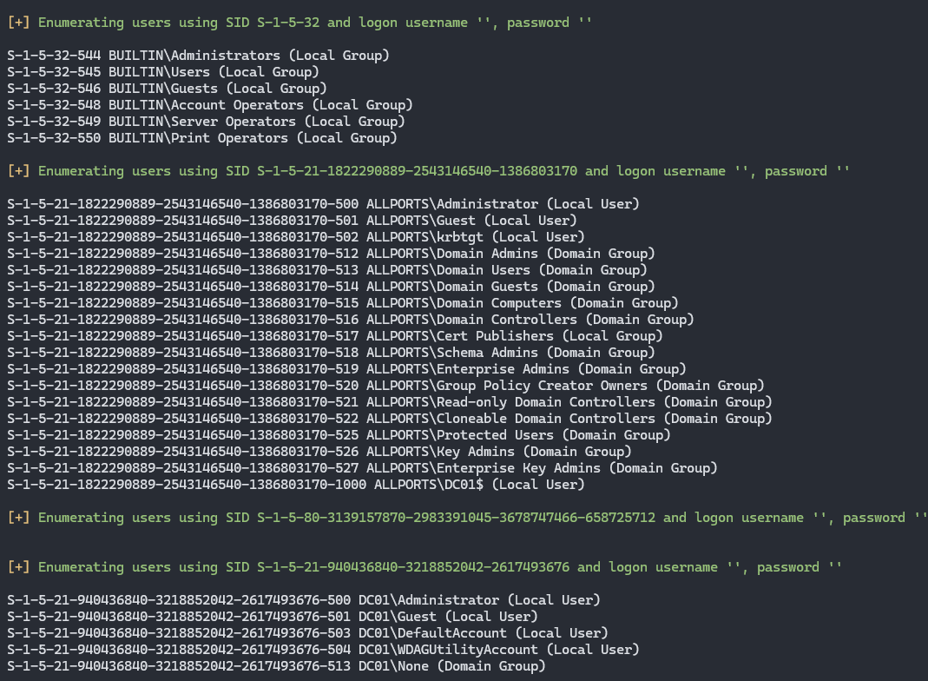

Enumeration
enum4linux 10.100.10.1

Slide 24
Enumeration - Demo
enum4linux -a 10.100.62.83
-a: Do all simple enumeration
10.100.10.1: Target IP of machine

Slide 25
Basic Attacks

Slide 26
Default Credentials
Many services use credentials, which are automatically configured to a default on creation.
If not configured, these services can be accessed using default credentials to gain a foothold into a machine.

Slide 27
Credential Reuse
A misconfiguration that can give attackers more control over the machine.
Upon accessing one service, can move laterally to other services from the same credentials or discovered ones.

Slide 28
Empty Passwords
A vulnerable configuration that allows users to have a blank password.
Using SSH on a user that has an empty password will not prompt for a password and instantly log you in.
Makes brute forcing much easier as now only users need to be found / guessed to find one with a blank password.

Slide 29
Questions?

Slide 30

Thank You!

